Slide 1
CS3006 Parallel and Distributed Computing
Fall 2022
National University of Computer and Emerging Sciences

Slide 2
Chapter 7. Programming Shared Address Space Platforms

Slide 3
Synchronization Across Multiple for Directives
Often, it is desirable to have a sequence of for-directives within a parallel construct that do not execute an implicit barrier at the end of each for directive.
OpenMP provides a clause – nowait, which can be used with a for directive to indicate that the threads can proceed to the next statement without waiting for all other threads to complete the for loop execution.

Slide 4
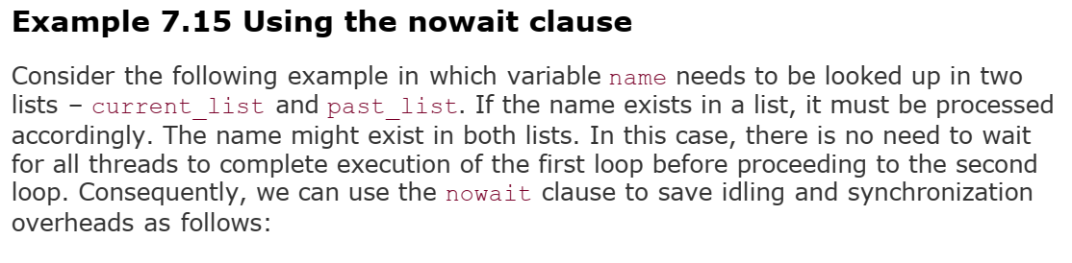

Slide 5
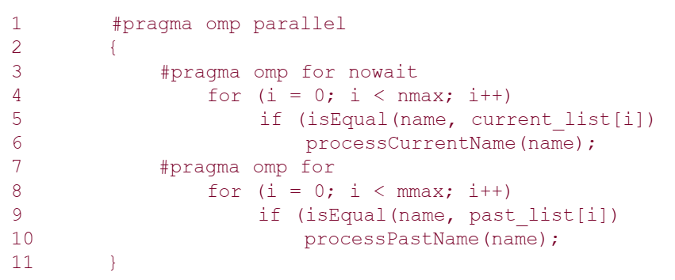

Slide 6
The sections Directive
OpenMP supports such non-iterative parallel task assignment using the sections directive.
The general form of the sections directive is as follows:
#pragma omp sections [clause list]
{
[#pragma omp section
/* structured block */
]
[#pragma omp section
/* structured block */
]
...
}

Slide 7
The sections Directive
This sections directive assigns the structured block corresponding to each section to one thread
(indeed more than one section can be assigned to a single thread).
The clause list may include the following clauses – private, firstprivate, lastprivate, reduction, and nowait.

Slide 8
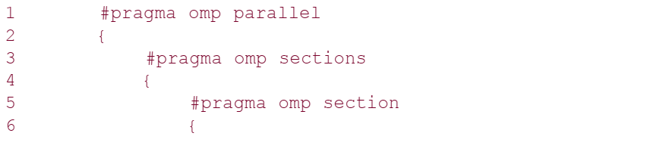
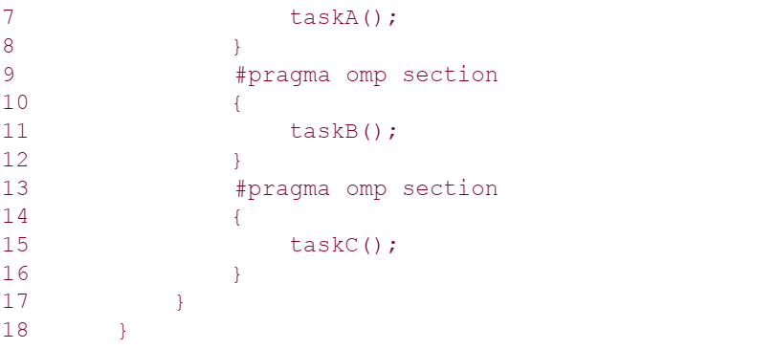

Slide 9
Class Tasks
Write an OpenMP Program to display the difference between a STATIC Schedule and a Dynamic Schedule.
Write a Parallel C++ program to calculate WORDCOUNT of some text file. Your program must have reduction clause, and also display the local results of each thread
Repeat task#2 without using the REDUCTION clause.
HINT: Single directive

Slide 10
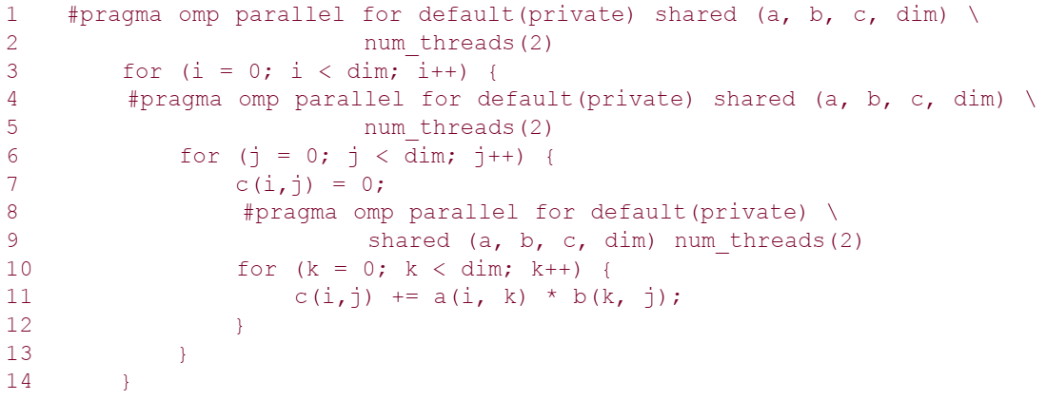
Nesting parallel Directives

Slide 11
The code as written only generates a logical team of threads on encountering a nested parallel directive.
The newly generated logical team is still executed by the same thread corresponding to the outer parallel directive.
To generate a new set of threads, nested parallelism must be enabled using the OMP_NESTED environment variable.
If the OMP_NESTED environment variable is set to FALSE, then the inner parallel region is serialized and executed by a single thread.
If the OMP_NESTED environment variable is set to TRUE, nested parallelism is enabled.
Notes:
https://www.twilio.com/blog/2017/01/how-to-set-environment-variables.html

Slide 12
Synchronization Constructs in OpenMP
The need for coordinating the execution of multiple threads may be the result of a desired execution order, the atomicity of a set of instructions, or the need for serial execution of code segments.
The Pthreads API supports mutexes and condition variables.

Slide 13
The barrier Directive
OpenMP provides a barrier directive, whose syntax is as follows:
#pragma omp barrier
On encountering this directive, all threads in a team wait until others have caught up, and then release.
When used with nested parallel directives, the barrier directive binds to the closest parallel directive.
For executing barriers conditionally, it is important to note that a barrier directive must be enclosed in a compound statement that is conditionally executed.

Slide 14
Single Thread Executions: The single and master Directives
Often, a computation within a parallel section needs to be performed by just one thread.
A simple example of this is the computation of the mean of a list of numbers.
A single directive specifies a structured block that is executed by a single (arbitrary) thread.
The syntax of the single directive is as follows:
#pragma omp single [clause list]
/* structured block */

Slide 15
Single Thread Executions: The single and master Directives
On encountering the single block, the first thread enters the block. All the other threads proceed to the end of the block.
If the nowait clause has been specified at the end of the block, then the other threads proceed; otherwise they wait at the end of the single block for the thread to finish executing the block.

Slide 16
Single Thread Executions: The single and master Directives
The master directive is a specialization of the single directive in which only the master thread executes the structured block.
The syntax of the master directive is as follows:
#pragma omp master
/* structured block */

Slide 17
Critical Sections: The critical and atomic Directives
In our discussion of Pthreads, we had examined the use of locks to protect critical regions
OpenMP provides a critical directive for implementing critical regions.
The syntax of a critical directive is:
#pragma omp critical [(name)]
structured block

Slide 18
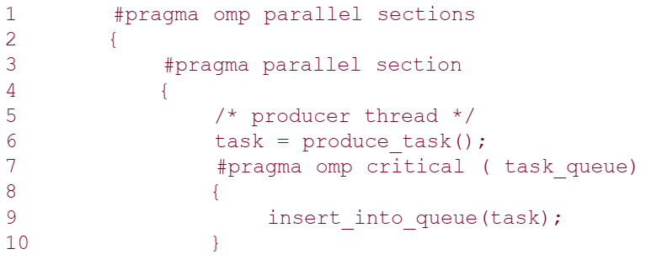
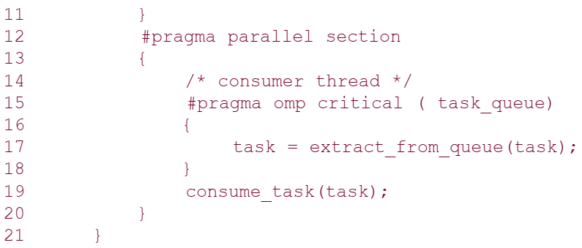

Slide 19
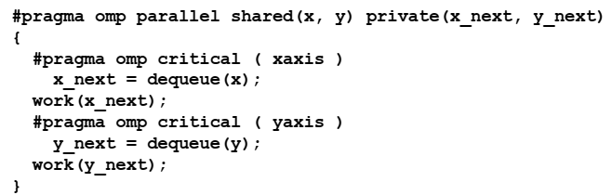

Slide 20
Critical Sections: The critical and atomic Directives
It is easy to see that the critical directive is a direct application of the corresponding mutex function in Pthreads.
There are some obvious safeguards that must be noted while using the critical directive.
The block of instructions must represent a structured block, i.e., no jumps are permitted into or out of the block.
Jumping in would result in non-critical access and jumping out would result in an unreleased lock, which could cause the threads to wait indefinitely.

Slide 21
In-Order Execution: The ordered Directive
In many circumstances, it is necessary to execute a segment of a parallel loop in the order in which the serial version would execute it.
For example, consider a for loop in which, at some point, we compute the cumulative sum in array cumul_sum of a list stored in array list.
The array cumul_sum can be computed using a for loop over index i serially by executing cumul_sum[i] = cumul_sum[i-1] + list[i].
When executing this for loop across threads, it is important to note that cumul_sum[i] can be computed only after cumul_sum[i-1] has been computed.
Therefore, the statement would have to executed within an ordered block.

Slide 22
In-Order Execution: The ordered Directive
The syntax of the ordered directive is as follows:
#pragma omp ordered
structured block
Since the ordered directive refers to the in-order execution of a for loop, it must be within the scope of a for or parallel for directive.
Furthermore, the for or parallel for directive must have the ordered clause specified to indicate that the loop contains an ordered block.
Ordered sections are useful for sequentially ordering the output from work that is done in parallel

Slide 23
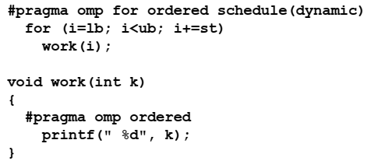

Slide 24
Chapter 6. Programming Using the Message Passing Paradigm

Slide 25
Recall…
A message-passing platform consists of p processing nodes, each with its own exclusive address space.
Interactions between processes running on different nodes must be accomplished using messages (data, work, and to synchronize actions among the processes), hence the name message passing.
The basic operations in this programming paradigm are send and receive.
The message-passing programming paradigm is one of the oldest and most widely used approaches for programming parallel computers.

Slide 26
Principles of Message-Passing Programming
The two key attributes to characterize the message-passing programming paradigm.
The first is that it assumes a partitioned address space
Second is that it supports only explicit parallelization.
There are two immediate implications of a partitioned address space.
First, each data element must belong to one of the partitions of the space; hence, data must be explicitly partitioned and placed.
The second implication is that all interactions (read-only or read/write) require cooperation of two processes - the process that has the data and the process that wants to access the data

Slide 27
Principles of Message-Passing Programming
Message-passing programs are often written using the asynchronous or loosely synchronous paradigms
In the asynchronous paradigm, all concurrent tasks execute asynchronously.
However, such programs can be harder to reason about, and can have nondeterministic behavior due to race conditions .
In the loosely synchronous model, tasks or subsets of tasks synchronize to perform interactions. Between these interactions, tasks execute completely asynchronously.
Most message-passing programs are written using the single program multiple data (SPMD) model.
Notes:
The message-passing programming paradigm requires that the parallelism is coded explicitly by the programmer.
In its most general form, the message-passing paradigm supports execution of a different program on each of the p processes. This provides the ultimate flexibility in parallel programming, but makes the job of writing parallel programs effectively unscalable.
In SPMD programs the code executed by different processes is identical except for a small number of processes (e.g., the "root" process)

Slide 28
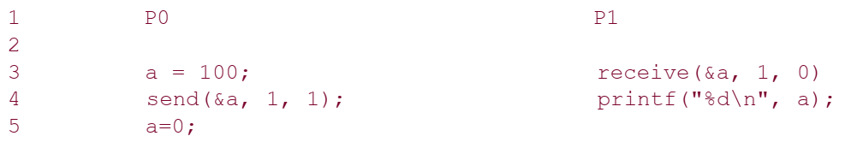
The Building Blocks: Send and Receive Operations
In their simplest form, the prototypes of these operations are defined as follows:
send(void *sendbuf, int nelems, int dest)
receive(void *recvbuf, int nelems, int source)
Notes:
The semantics of the send operation require that the value received by process P1 must be 100 as opposed to 0.
This motivates the design of the send and receive protocols.

Slide 29
The semantics of the send operation require that the value received by process P1 must be 100 as opposed to 0.
This motivates the design of the send and receive protocols.

Slide 30
MPI: the Message Passing Interface (Chapter#6)
MPI defines a standard library for message-passing that can be used to develop portable message-passing programs using either C or Fortran.
The MPI standard defines both the syntax as well as the semantics of a core set of library routines.
The MPI library contains over 125 routines, but the number of key concepts is much smaller, it is possible to write fully-functional message-passing programs by using only the six routines
These routines are used to initialize and terminate the MPI library, to get information about the parallel computing environment, and to send and receive messages.

Slide 31
MPI: the Message Passing Interface
MPI_Init | Initializes MPI.
MPI_Finalize | Terminates MPI.
MPI_Comm_size | Determines the number of processes.
MPI_Comm_rank | Determines the label of calling process.
MPI_Send | Sends a message.
MPI_Recv | Receives a message.

Slide 32
Starting and Terminating MPI Library
MPI_Init is called prior to any calls to other MPI routines.
Its purpose is to initialize the MPI environment.
Calling MPI_Init more than once during the execution of a program will lead to an error.
MPI_Finalize is called at the end of the computation, and it performs various cleanup tasks to terminate the MPI environment.
No MPI calls may be performed after MPI_Finalize has been called, not even MPI_Init

Slide 33
The prototypes of these two functions are:
int MPI_Init(int *argc, char ***argv)
int MPI_Finalize()
All MPI routines, data-types, and constants are prefixed by “MPI_”.

Slide 34
Communicators
A key concept used throughout MPI is that of the communication domain.
A communication domain is a set of processes that are allowed to communicate with each other.
Information about communication domains is stored in variables of type MPI_Comm, that are called communicators .

Slide 35
Communicators
A process can belong to many different (possibly overlapping) communication domains
MPI defines a default communicator called MPI_COMM_WORLD which includes all the processes.

Slide 36
Communicators
Communicator holds a group of processes that can communicate with each other.
All message passing calls in MPI must have a specific communicator to use the call with.
An example of a communicator handle is MPI_COMM_WORLD. MPI_COMM_WORLD is the default communicator that contains all processes available for use.
Can be created and destroyed during program execution.

Slide 37
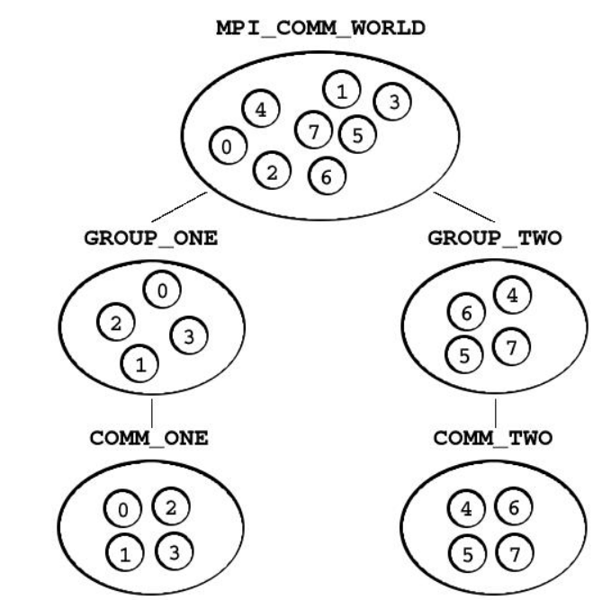

Slide 38
Getting Information
The MPI_Comm_size and MPI_Comm_rank functions are used to determine the number of processes and the label of the calling process, respectively.
The calling sequences of these routines are as follows:
int MPI_Comm_size(MPI_Comm comm, int *size)
int MPI_Comm_rank(MPI_Comm comm, int *rank)
The rank of a process is an integer that ranges from zero up to the size of the communicator minus one.

Slide 39
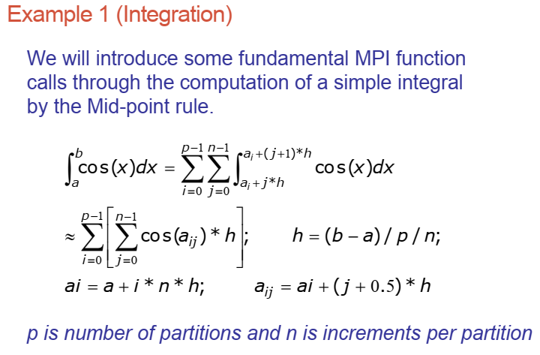
Lab

Slide 40
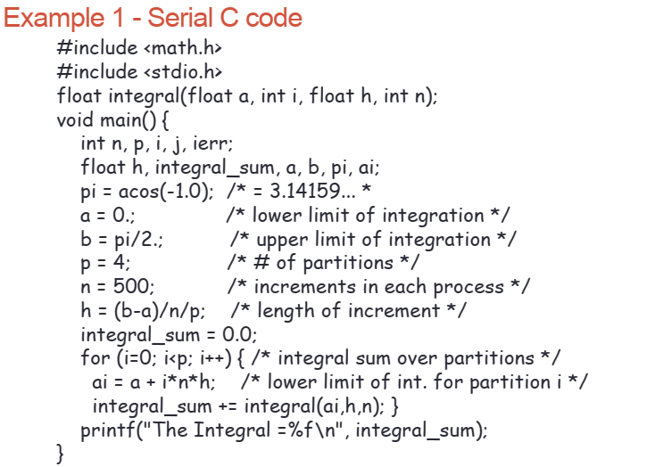

Slide 41
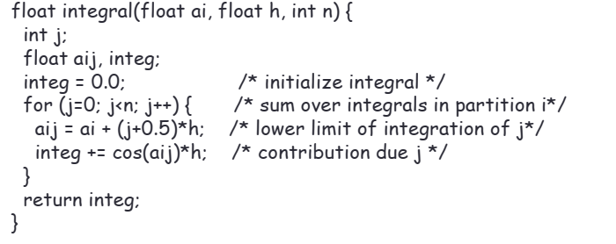

Slide 42
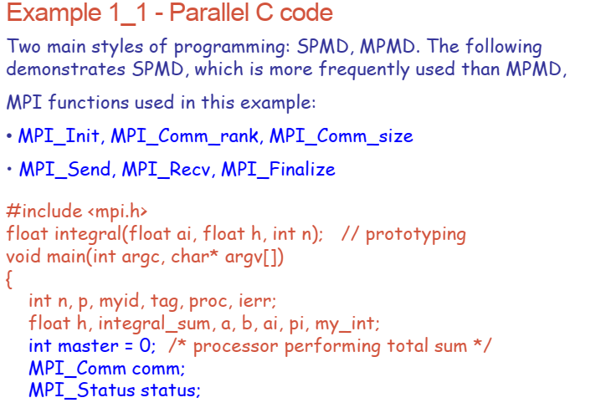

Slide 43
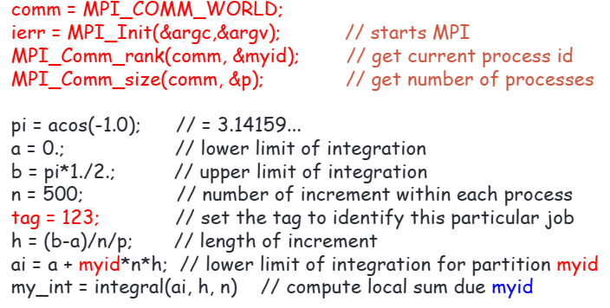

Slide 44
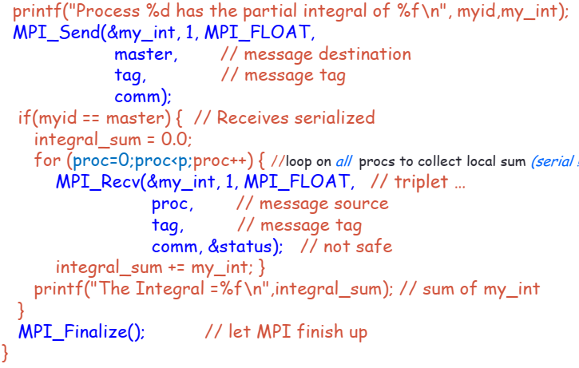

Slide 45
Our First MPI Program
#include <mpi.h>
main(int argc, char *argv[])
{
int npes, myrank;
MPI_Init(&argc, &argv);
MPI_Comm_size(MPI_COMM_WORLD, &npes);
MPI_Comm_rank(MPI_COMM_WORLD, &myrank);
printf("From process %d out of %d, Hello World!\n", myrank, npes);
MPI_Finalize();
}

Slide 46
Lab Task(s)
Write a Parallel C++ program with OpneMP to calculate WORDCOUNT of some text file. Your program must have reduction clause, and also display the local results of each thread.
Download, Install and Configure MPI. Write a MPI C program to print the statement "Hello, I am process X of Y processes“
where X is the current process while Y is the number of processes for job

Slide 47
MPI Datatypes
MPI Datatype | C Datatype
MPI_CHAR | signed char
MPI_SHORT | signed short int
MPI_INT | signed int
MPI_LONG | signed long int
MPI_UNSIGNED_CHAR | unsigned char
MPI_UNSIGNED_SHORT | unsigned short int
MPI_UNSIGNED | unsigned int
MPI_UNSIGNED_LONG | unsigned long int
MPI_FLOAT | float
MPI_DOUBLE | double
MPI_LONG_DOUBLE | long double
MPI_BYTE
MPI_PACKED

Slide 48
Running an MPI Program
mpicc program_name.c -o object_file
mpirun -np [number of processes] ./object_file

Slide 49
The basic functions for sending and receiving messages in MPI are the MPI_Send and MPI_Recv respectively.
int MPI_Send(void *buf, int count, MPI_Datatype datatype,
int dest, int tag, MPI_Comm comm)
int MPI_Recv(void *buf, int count, MPI_Datatype datatype,
int source, int tag, MPI_Comm comm, MPI_Status *status)

Slide 50
MPI_Send
MPI_Send sends the data stored in the buffer pointed by
buf :initial address of send buffer (choice).
count:number of elements in send buffer (nonnegative integer).
datatype: datatype of each send buffer element (handle)
dest: rank of destination (integer)
tag: message tag (integer), each message has an integer-valued tag associated with it to distinguish different types of messages.
comm: communicator (handle)
The dest argument is the rank of the destination process in the communication domain specified by the communicator comm .

Slide 51
MPI_Recv
int MPI_Recv(void *buf, int count, MPI_Datatype datatype, int source, int tag, MPI_Comm comm, MPI_Status *status)
MPI_Recv receives a message sent by a process whose rank is given by the source in the communication domain specified by the comm argument.
The received message is stored in continuous locations in the buffer pointed to by buf .
The tag of the sent message must be that specified by the tag argument.
If there are many messages with identical tag from the same process, then any one of these messages is received

Slide 52
MPI_Recv
int MPI_Recv(void *buf, int count, MPI_Datatype datatype, int source, int tag, MPI_Comm comm, MPI_Status *status)
MPI allows specification of wildcard arguments for both source and tag.
If source is set to MPI_ANY_SOURCE , then any process of the communication domain can be the source of the message.
Similarly, if tag is set to MPI_ANY_TAG , then messages with any tag are accepted.

Slide 53
MPI_Recv
int MPI_Recv(void *buf, int count, MPI_Datatype datatype, int source, int tag, MPI_Comm comm, MPI_Status *status)
The count and datatype arguments of MPI_Recv are used to specify the length of the supplied buffer.
The received message should be of length equal to or less than this length.

Slide 54
MPI_Recv
int MPI_Recv(void *buf, int count, MPI_Datatype datatype, int source, int tag, MPI_Comm comm, MPI_Status *status)
After a message has been received, the status variable can be used to get information about the MPI_Recv operation.
In C, status is stored using the MPI_Status data-structure.

Slide 55
The corresponding data structure contains:
typedef struct MPI_Status {
int MPI_SOURCE;
int MPI_TAG;
int MPI_ERROR; };
MPI_SOURCE and MPI_TAG store the source and the tag of the received message.
They are particularly useful when MPI_ANY_SOURCE and MPI_ANY_TAG are used for the source and tag arguments.
MPI_ERROR stores the error-code of the received message.

